Slide 1
Is it true that females are less successful in STEM courses
Final project DSC530
By Matt Kline

Slide 2
Variables selected
Gender
The data is binary of Male or Female.
Parental Level of Education
This states what the parent’s highest education is. In some cases it is believed that a student performs better in school if their parent’s have a higher education.
Lunch
Students either have free/reduced lunch or standard lunch. They only receive free/reduced based off of their family’s economic status.
Test Preparation
If a student has completed a test prep course or not.
Math, Reading, Writing scores:
These variables are the students grade for the specified class.
Average score
A created variable that is the average over all grade for the 3 classes.

Slide 3
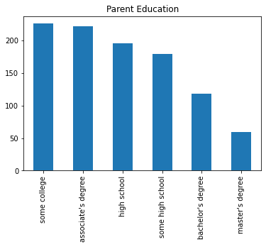
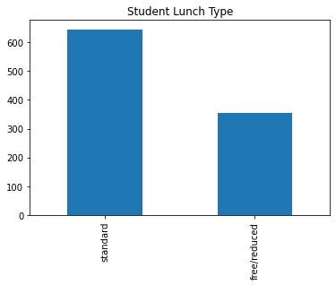
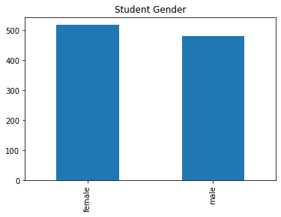
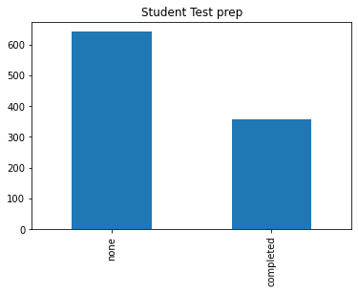
Categorical Graphs
Gender, lunch, and Parent’s education are all categorical variables. For these graphs we are looking at the count of the specified values. We can see from these graphs, roughly the same amount of male and females were polled. The higher the education the less likely it was to be had. Almost double the amount of students had standard lunch than having free/reduced lunch. Only a third of the students completed any type of test prep.

Slide 4
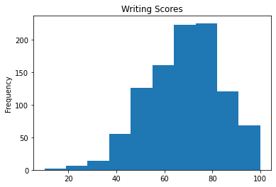
Writing Scores
The peak of this data ranges from 60-80 for the grades in this course. The graph is slightly skewed to the left.
Mean: 68.05
Median: 69
Mode: 74
Standard Deviation: 15.2

Slide 5
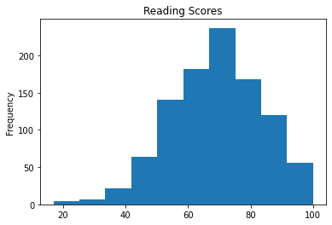
Reading Scores
The reading scores had a clear peak of 70 with a slight skew towards the left as well.
Mean: 69.1
Median: 70
Mode: 72
Standard Deviation: 14.6

Slide 6
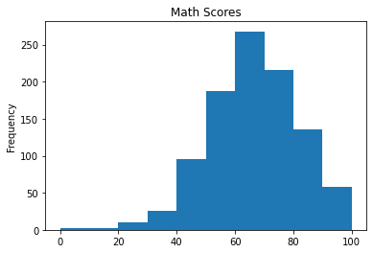
Math Scores
The Math Scores peak at 70. The Math scores have the least amount of skew in the data between the 3 scores.
Mean: 66
Median: 66
Mode: 65
Standard Deviation: 15.16

Slide 7
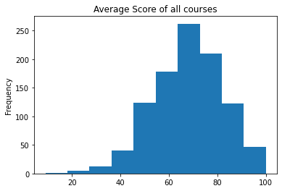
Overall Average Scores
These scores have a peak of 70 with a slight skew to the left. Because this column is a combination of all 3 it is predictable that the graph will look fairly similar to them, since there were no real outliers.
Mean: 67.7
Median: 68.3
Mode: 68
Standard Deviation: 14.25

Slide 8
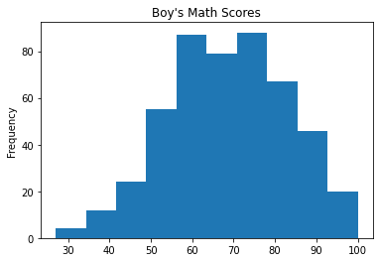
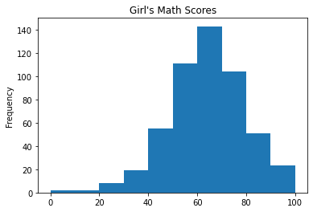
Male vs Female Math Scores

Slide 9
Male vs Female Math Scores
The girls data has a peak of 70 and is slightly skewed to the left, where as the boys data peaks from 60-80.
Mean M:68.7 F:63.6
Median M:69 F:65
Mode M:62 F:65
Standard Deviation M:14.35 F:15.49
From the graphs and the data we can tell that the Males have more higher grades in math, and don’t have any that go below 30. The females have grades that range from 0-20 which is skewing there data and making it seem like they don’t score as high as the boys when in reality they are only slightly off.

Slide 10
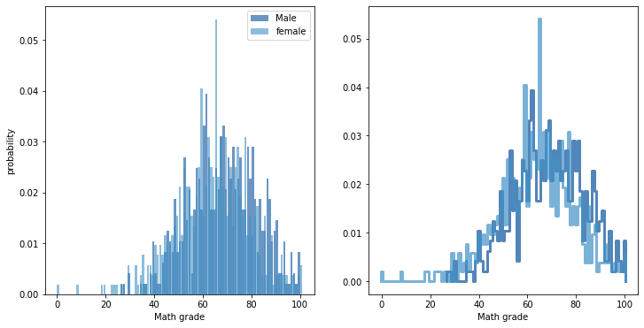
PMF Male vs Female
I looked at the pmf of the Male and Female math grades (since Math is the only STEM course in the data set). From the graphs what we can see is that the males are not likely to get a grade below 30, then both male and females have about the same probability on grades till 70 where girls are most likely to get that score. After 70, at about all other grades Males have a higher probability of scoring than females do.

Slide 11
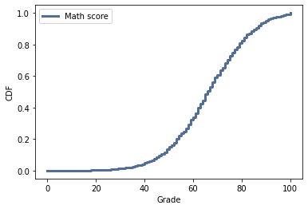
CDF on Math Scores
From the graph we can see that Math scores have little to no variance until about 50%. The variance starts off low and gradually gets larger till about 70% where the variance lowers until about 90% where there is almost no variance again. These scores have a Normalized curve since the overall variance is low.

Slide 12
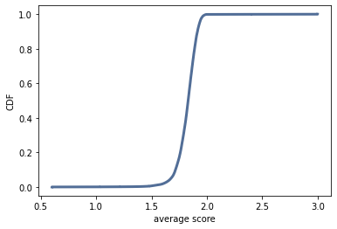
Lognormal Distribution
This lognormal distribution helps confirm if our data is a normal distribution. Do to the lack of variance, we don’t see any skew in our distribution.

Slide 13
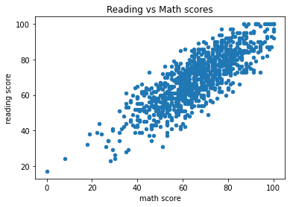
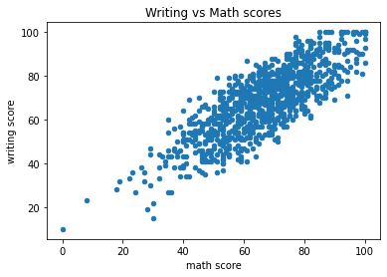
Math vs Reading/Writing Scores
Both of these scatter plots have the same general shape and direction. Both show a strong positive correlation. They are mostly linear, but not a strong linear relation. This allows us to conclude that if you are good at math you are likely to be above average at reading and writing.

Slide 14
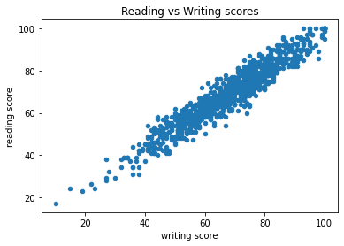
Writing vs Reading Scores
This graph shows a strong positive relationship, and a strong linear correlation. Based off this graph it is likely to be that if you are good at reading you are also good at writing and vise versa.

Slide 15
Hypothesis testing
I ran a test that would show if Math scores was affected by being Male or Female, the test resulted in 0 every time resulting in rejecting the null hypothesis. This data set and test proves the stereotype of Females being worse in STEM related courses wrong.

Slide 16
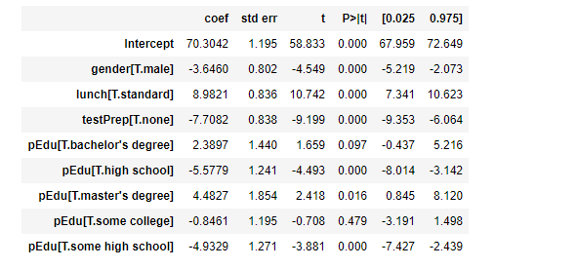
Regression Analysis
I ran a regression on Average scores, where I took into account Parent’s education, Gender, Lunch type, and Test preparation. Here are the Results:

Slide 17
Resources
Data set: https://www.kaggle.com/spscientist/students-performance-in-exams
Code Location: https://github.com/mkline3/ThinkStats2/blob/master/code/FinalProjectKline.ipynb
Book: ThinkStats2 https://greenteapress.com/thinkstats2/thinkstats2.pdf

